Slide 1

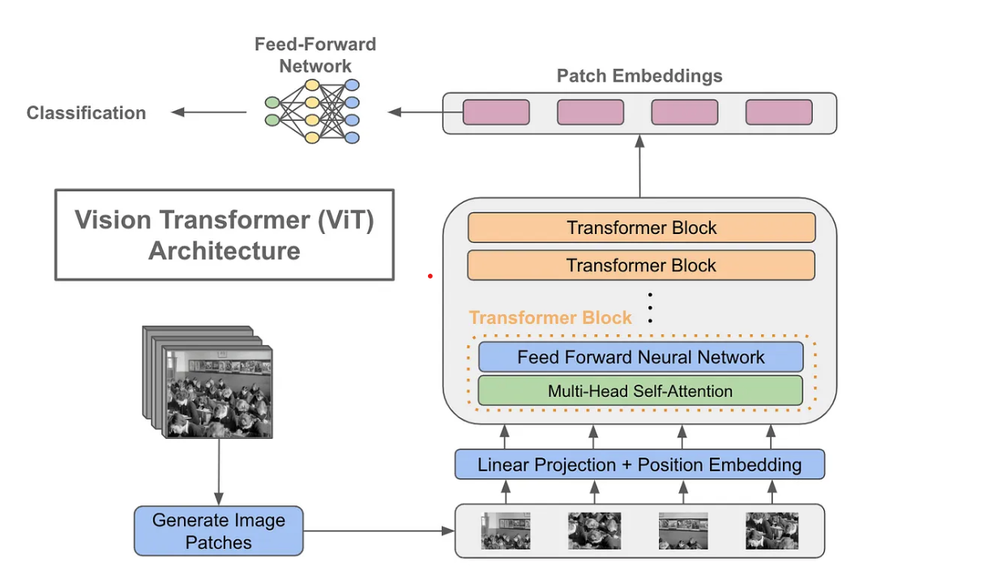


Smart Apple Picking Prediction using IOT
Sai Harish Chitluri, Surya Anirudh Lanka, Dhanunjaya Koneru, Pushpa Uppala, Nagaraju Rathna, BadiriNadh Mamidi, Gopi Rao
Advisor: Dr. Sejun Song, University of Missouri – Kansas City
MOTIVATION:
In traditional apple picking methods, challenges arise, leading to inefficiencies and inaccuracies. The need for a more efficient and accurate apple picking process is crucial for optimizing harvests. Our solution leverages Machine Learning (ML) and the Internet of Things (IoT) to create a modern and efficient apple picking system.
MOTIVATION:
CURRENT PROBLEMS WITH APPLE PICKING
WORKING OF SMART-PICK
Traditional apple picking methods are often labor-intensive, requiring significant manual effort.
Human error in selecting ripe apples for harvesting may lead to the picking of unripe or overripe fruits.
The conventional method of visually inspecting each apple is time-consuming, especially in large orchards.
The smart apple picking system consists of three main components:
A mobile app: The user uses the mobile app to scan the apple.
A vision transformer model: The model analyzes the image of the apple and classifies it as ripe or unripe.
A decision-making system: The system uses the results of the vision transformer model to decide whether or not to pick the apple.
We collected a data set of 4,000 images of apples.
The images were labeled as ripe or unripe.
We used this data set to train the vision transformer model.
OUR SOLUTION: SMART PICKING
We combine ML and IoT to revolutionize the smart apple picking process.
Vision Transformers: Vision transformers were chosen for their effectiveness in image recognition tasks.
The model is finetuned using a dataset of 4000 labeled images for optimal performance.
Mobile app integration: Users can employ a mobile app for real-time apple scanning with instant feedback.
VISION TRANSFORMERS
Vision Transformers (ViTs) represent a breakthrough in computer vision, challenging traditional Convolutional Neural Networks (CNNs) for image classification tasks..
ViTs adapt the transformer architecture to process images as sequences of patches rather than grids of pixels.
Images are divided into smaller patches, treating each patch as a sequence of values.
ViTs excel at capturing long-range dependencies in images, making them well-suited for tasks like image classification and object detection.
RESULTS & PERFOMANCE
Accuracy: The model demonstrates high accuracy of 93% during testing, ensuring reliable predictions.
Real-world testing: Field testing and validation results contribute to the real-world applicability of the solution.
Efficiency gains: The solution significantly improves efficiency compared to traditional apple picking methods.
APPLE TYPE RECOGNITION
We gathered a dataset comprising images of 3 different apple types, including green apples, honey crisp apples, red apples.
Automated solutions are essential for efficiently handling the extensive variety of apples.
We employ machine learning techniques, including deep neural networks, to
recognize and classify apple types based on visual features.
The combination of apple type recognition and picking prediction enhances the
precision and efficiency of the harvesting process.
The flexibility of the model allows for easy expansion to recognize additional apple varieties.
CONCLUSION
Vision transformers offer a promising solution for smart apple picking.
The smart apple picking system can improve efficiency and profitability in apple orchards.
This technology has the potential to revolutionize the apple industry.
Results & Performance
https://github.com/SuryaAnirudh/SmartApplePicking.git
https://youtu.be/DweBqs5dlaQ

